Slide 1
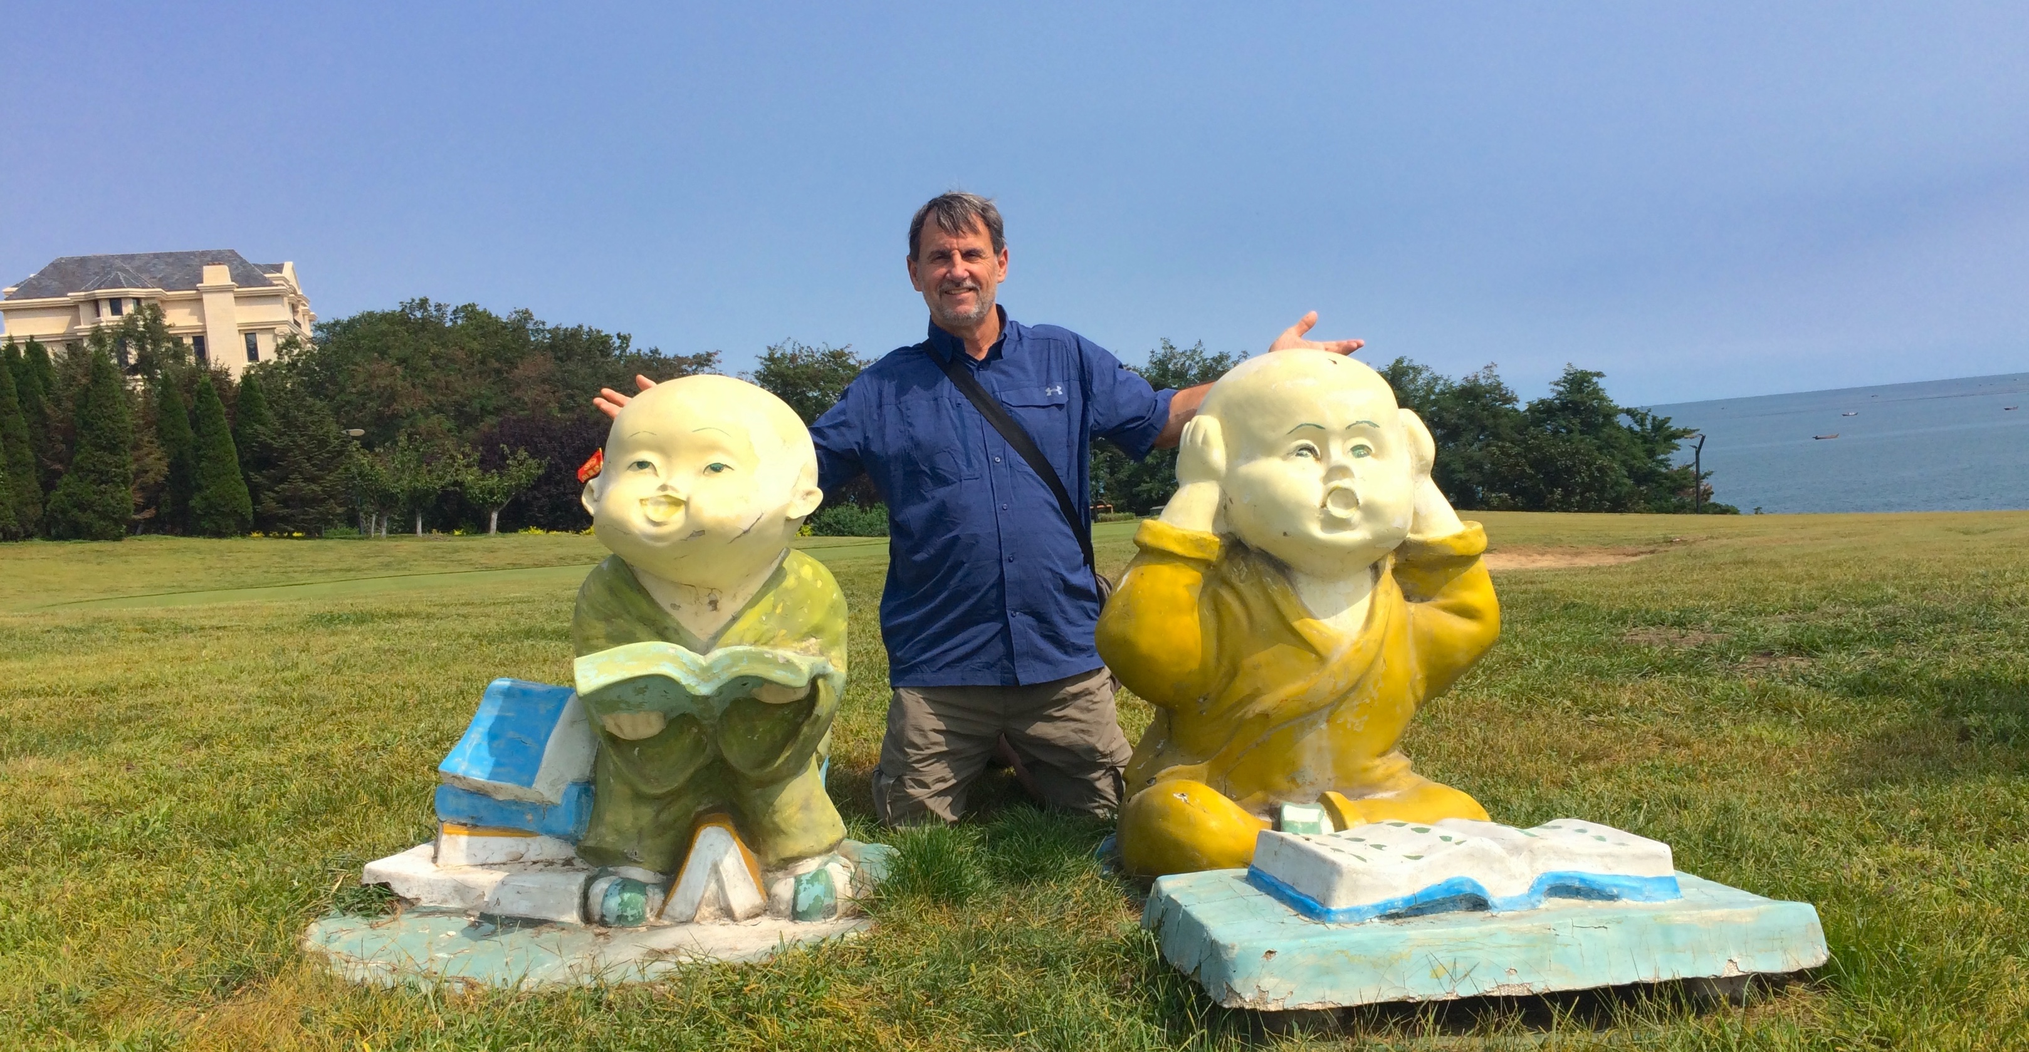
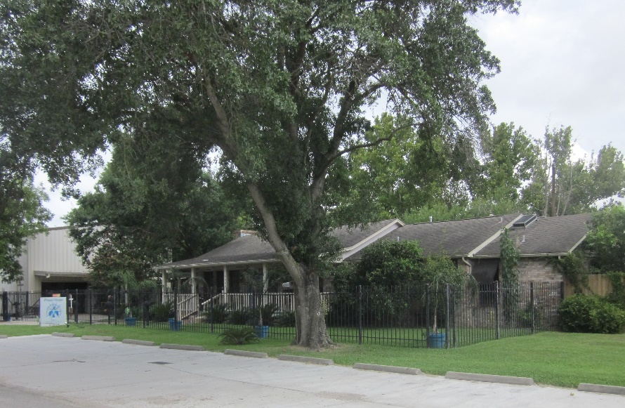
Beyond the Basics
Big Book 12 Step Recovery
BB12Step.com
Copyright © 2020 by the Anonymous Alliance of Charitable Organizations
(a Texas Non-Profit Corporation and 501(c)(3) Public Charity)
FREE TO USE & SHARE – DO NOT MODIFY
Author:
Ken Laney, JD, CPA
BB12Step@icloud.com
Date of Grace: 11/17/1994
Birthplace of the Program:
Power House Recovery Center
PowerHouseRecovery.com 713-442-1919

Slide 3
BIG BOOK (BB)
ALCOHOLICS ANONYMOUS
“SURVIVAL GUIDE”
“DO-OR-DIE” DIRECTIVES
HOPELESS ALCOHOLICS
The
of
is a
with
for

Slide 4
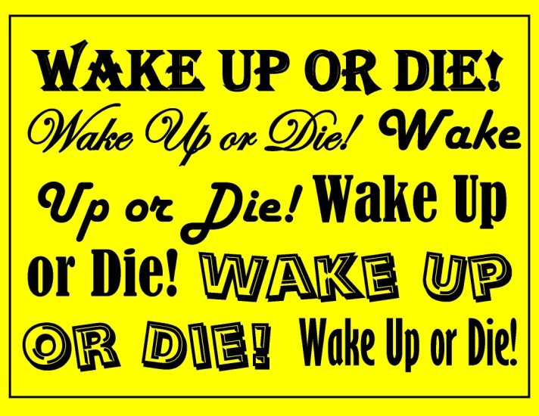
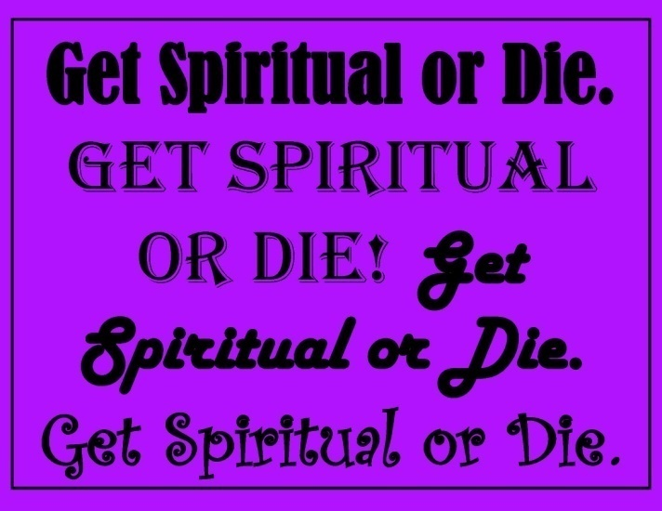
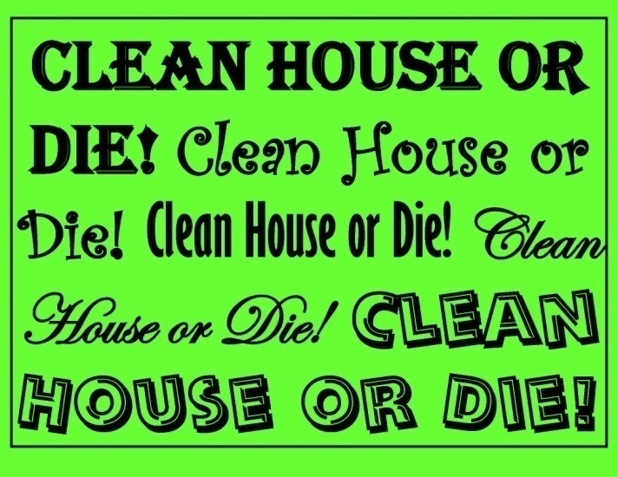
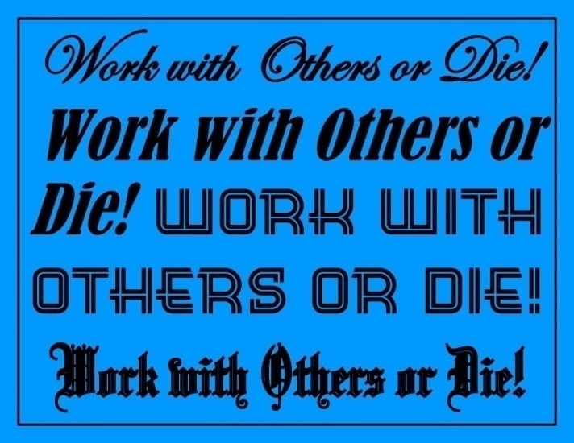
Four “Do-or-Die” Directives from the Big Book
1) 2)
3) 4)

Slide 5
(Revised: 09/22/2020)
Beyond the Basics Big Book 12 Step Recovery
Copyright © 2020 by the Anonymous Alliance of Charitable Organizations
(a Texas Non-Profit Corporation and 501(c)(3) Public Charity)
FREE TO USE & SHARE – DO NOT MODIFY
BB12Step.com
Opening the Meeting

Slide 6
Opening:
Welcome to the 7 PM Monday night “BEYOND HUMAN AID” group. We have “set apart one night a week for a meeting to be attended by anyone or everyone interested in a spiritual way of life.”(Big Book p.159)
My name is ______ and I am an Alcoholic.
Anyone here for their first AA Meeting?
Any first time visitors attending this group?
In accordance with 7th tradition, we will be passing the basket during the meeting.

Slide 7
Prayer & Meditation:
Please join with us now to open this meeting with the THIRD STEP PRAYER.
Followed by a moment of silence for each to use in his or her own way.
- Prayer -
(Go to next slide - recite 3rd Step prayer)
- Meditation -
(Follow with a moment of silence)

Slide 8
Third Step Prayer
God, I offer myself to Thee – to build with me and to do with me as Thou wilt.
Relieve me of the bondage of self, that I may better do Thy will.
Take away my difficulties, that victory over them may bear witness to those I would help of Thy Power, Thy Love, and Thy Way of life. May I do Thy will always. (p.63)
(Follow with a moment of silence)

Slide 9
(Revised: 08/27/2020)
Beyond the Basics Big Book 12 Step Recovery
Copyright © 2020 by the Anonymous Alliance of Charitable Organizations
(a Texas Non-Profit Corporation and 501(c)(3) Public Charity)
FREE TO USE & SHARE – DO NOT MODIFY
BB12Step.com
BB12Step Meeting Preamble

Slide 10
BB12Step Meeting Preamble
We are gathered here because we are faced with the fact that we are powerless over alcohol and are unable to do anything about it without the help of a Power greater than ourselves. (1940 AA Preamble)
Probably no human power could have relieved our alcoholism. (Big Book p.60)
The simple purpose of our program is to show what may be done to enlist the aid of a Power greater than ourselves. (1940 AA Preamble)

Slide 11
BB12Step Meeting Preamble
Rarely have we seen a person fail who has thoroughly followed our program. ... Now you may like this program or you may not, but the fact remains, it works. It is our only chance to recover. (1940 AA Preamble)
We do not speak for A.A. as a whole and you are free to agree or disagree as you see fit, in fact, it is suggested that you pay no attention to anything which might not be reconciled with what is in the A.A. Big Book. (1940 AA Preamble)

Slide 12
BB12Step Meeting Preamble
There are no dues or fees. The only requirement for membership is a desire to stop drinking. Each member squares his debt by helping others to recover.
(1940 AA Preamble)
Our REAL PURPOSE is to fit ourselves to be of maximum service to God and the people about us. (Big Book p.77) Big Book
Faith has to work twenty-four hours a day in and through us or we perish.
Note: This composition was created using quotes from the 1940 AA Preamble and Big Book of Alcoholics Anonymous
(Big Book p.16) &
(1940 AA Preamble)

Slide 13
(Revised: 08/28/2020)
Beyond the Basics Big Book 12 Step Recovery
Copyright © 2020 by the Anonymous Alliance of Charitable Organizations
(a Texas Non-Profit Corporation and 501(c)(3) Public Charity)
FREE TO USE & SHARE – DO NOT MODIFY
BB12Step.com
Key Word: “HONESTY”

Slide 14
Big Book (BB) Key Word: Honesty (Rigorous)
(Revised: 08/28/2020)
def. hon·es·ty /ˈänəstē /
1. the quality of being honest
(i.e. speaking the truth; upright conduct)
SYNONYMS: truthful, Trustworthy, Reliable, True
ANTONYMS: lying, dishonest, delusional, fraud
def. rig·or·ous /ˈriɡ(ə)rəs /
1. severely exact or accurate; strict, precise

Slide 15
What does the Big Book Say?

Slide 16
BB Key Word: “HONESTY”
“But what about the real alcoholic?... He is often perfectly sensible and well balanced concerning everything except liquor, but in that respect he is incredibly dishonest and selfish.”(p.21)
The best test for honesty is truthfulness. How often have we lied to ourselves? Just because I “believe” a lie, that does not mean it’s not lying. Is it true, or not?
IF IT’S NOT TRUE, IT’S A LIE

Slide 17
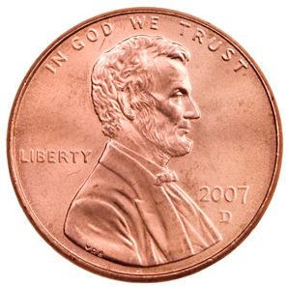
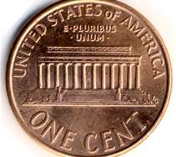
What does “Rigorous Honesty” look like to you?
Will you honestly try looking
at it another way?

Slide 18
Is this “Rigorous Honesty”?
I’m being Honest if I believe it!

Slide 19
Is this “Rigorous Honesty”?
I’m being Honest if it’s actually true!

Slide 20
BB Key Word: “HONESTY”
The best test for “rigorous honesty” is “truthfulness”. Does it match reality or is it make-believe? Is it fact or is it fiction? Is it actually true or false?
“they cannot after a time differentiate the true from the false.”(p.xxvi)
Example: If I said I’d be there at 8am, was it true or not? If not, then I lied! Excuses don’t change a lie into truth.
IF IT’S NOT TRUE, IT’S A LIE

Slide 22
BB Key Word: “HONESTY”
“RARELY HAVE we seen a person fail who has thoroughly followed our path. Those who do not recover are people who cannot or will not completely give them-selves to this simple program, usually men and women who are constitutionally incapable of being honest with them-selves.”(p.58) (Continued)
If a person was incapable of being honest with themselves, how would they know it?

Slide 23
BB Key Word: “HONESTY”
(Continued) “There are such unfortunates. ... They are naturally incapable of grasping and developing a manner of living which demands rigorous honesty.”... There are those, too, who suffer from grave emotional and mental disorders, but many of them do recover if they have the capacity to be honest”(p.58)
Admitting that you might be incapable of being honest with yourself has often been just enough honesty to open the door.

Slide 25
BB Key Word: “HONESTY”
“My friend promised when these things were done I would enter upon a new relationship with my Creator; that I would have the elements of a way of living which answered all my problems. Belief in the power of God, plus enough willingness, willingness, honesty and humility to establish and maintain the new order of things, were the essential requirements. ... I must turn in all things to the Father of Light who presides over us all.”(p.13-14)

Slide 27
BB Key Word: “HONESTY”
Even so has God restored us all to our right minds. To this man, the revelation was sudden. Some of us grow into it more slowly. But He has come to all who have honestly sought Him. When we drew near to Him He disclose Himself to us!”(p.57)
Have you honestly sought Him? Step 3 is a decision. A decision without action is called a “fantasy”. Have you made an honest decision? Have you taken action?

Slide 28
Honestly

Slide 29
BB Key Word: “HONESTY”
“We can only clear the ground a bit. If our testimony helps sweep away prejudice, enables you to think honestly, encourages you to search diligently within yourself, then, if you wish, you can join us on the Broad Highway. With this attitude you cannot fail. the consciousness of your belief is sure to come to you.”(p.55)
Are you able to think honestly? To think honestly, we must also be openminded and willing. All three are indispensable.

Slide 31
(Revised: 08/28/2020)
Beyond the Basics Big Book 12 Step Recovery
Copyright © 2020 by the Anonymous Alliance of Charitable Organizations
(a Texas Non-Profit Corporation and 501(c)(3) Public Charity)
FREE TO USE & SHARE – DO NOT MODIFY
BB12Step.com
Discussion: “HONESTY”

Slide 32
Discussion
Was I rigorously honest
if it’s not actually true?
Excuses, fantasy, and denial will not pass a rigorous
“reality check”.
- Continued -

Slide 33
Discussion: “Honesty (Rigorous)”
Am I a real alcoholic? Have I actually been incredibly dishonest and selfish?
Is rigorous honesty tested by what “we believed” or by what is “actually true”?
Am I capable of being honest with myself? All the time? Some of the time? How would we even know?
Have I honestly decided to seek Him?
IF IT’S NOT TRUE, IT’S A LIE

Slide 34
(Revised: 10/04/2020)
Beyond the Basics Big Book 12 Step Recovery
Copyright © 2020 by the Anonymous Alliance of Charitable Organizations
(a Texas Non-Profit Corporation and 501(c)(3) Public Charity)
FREE TO USE & SHARE – DO NOT MODIFY
BB12Step.com
Closing the Meeting

Slide 35
Closing:
Does anyone need to pick up a chip?
Are there any AA related announcements?
If you have taken the Steps as outlined in the Big Book with a sponsor and have time to help someone, please raise your hand.
If you would like some help with our program, please let one of us know after the meeting - it would help us very much!
Trying “to carry this message to others”(p.60) “plays a vital part in our own recovery.”(p.94)

Slide 36
Closing Prayer:
“Please join us in closing this meeting
with the SEVENTH STEP PRAYER.”
(Go to next slide - recite 7th Step prayer)

Slide 37
Seventh Step Prayer
My Creator, I am now willing that you should have all of me, good and bad.
I pray that you now remove from me every single defect of character which stands in the way of my usefulness to you and my fellows.
Grant me strength, as I go out from here, to do your bidding. Amen. (p.76)

Slide 39
BIG BOOK (BB)
ALCOHOLICS ANONYMOUS
“SURVIVAL GUIDE”
“DO-OR-DIE” DIRECTIVES
HOPELESS ALCOHOLICS
The
of
is a
with
for

Slide 40
Four “Do-or-Die” Directives from the Big Book
1) 2)
3) 4)

